Slide 1
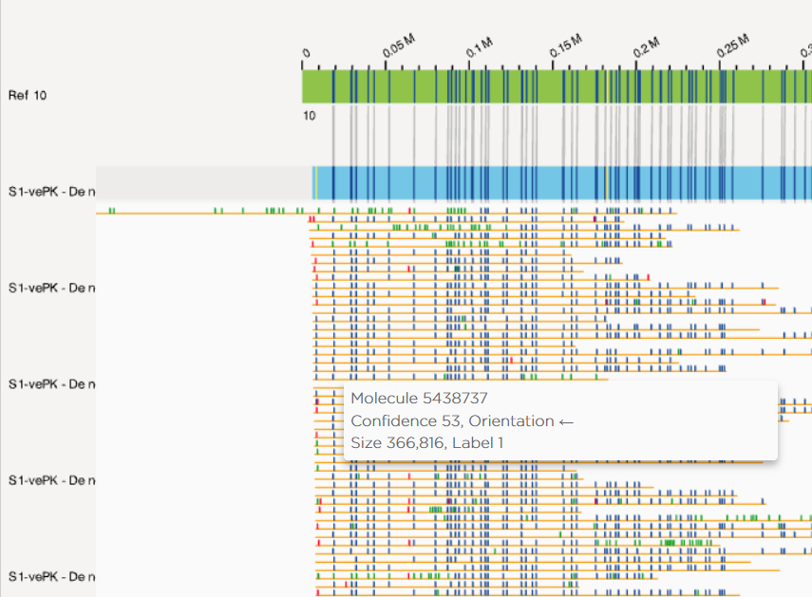

Overview & Visualization
Raw molecules = BNX file
alignment
Output:
Reference (hg38)
exp_refineFinal1_merged _r.cmap
exp_refineFinal1_merged.xmap
exp_refineFinal1_merged _q.cmap
Contig 271
Contig_r.cmap
Molecules
567302
Name (Contig+Molecule).xmap
5438737
Molecules_q.cmap
Notes:
Get files from this one into one folder

Slide 2
Positive, Negative orientations
0
7000
REFERENCE
0
CONTIG +
7000
7000
CONTIG -
0
0
MOLECULE +
7000
7000
MOLECULE -
0

Slide 3
Positive, Negative orientations
1 2 3 4 5 6 7 8 9 10 11 12 13 14 15 16 17 18 19 20
ref Contig # 271
exp_refineFinal1_contig271_r.cmap
103,145.7
38,643,782.5
Alignment string: (1,1)(2,2)(3,3)(4,4)
1 2 3 4 5 6 7 8 9 D 10 11 12 D D 13 14 15 16 17
Contig # 271: +
M. M. M M. M M. M. M. M. D. M. M. M. D. D. M. M. M. M. M
exp_refineFinal1_contig271.xmap
Alignment string: (1,14)(2,13)(4,12)(5,11)
Contig # 271: -
14 13 D 12 11 10 9 8 D 7 6 5 D 4 3 2 D 1
M. M. D M. M M. M. M. D. M. M. M. D. M. M. I. D. M
clipper
+ Molecule: 5442444
1 2 3 4 5 6 7 8 9 10 11 12 13 14 15 16 17. 18. 19
77069.2
103792.4
212477.1
250891.4
exp_refineFinal1_contig271_q.cmap
77069.2
238946.6
- Molecule: 2934810
1 2 3 4 5 6 7 8 9 10 11 12 13 14
7154.6
15233
106201
152060.5
9414.2
111263.4

Slide 4
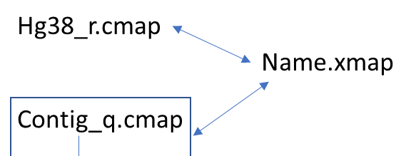
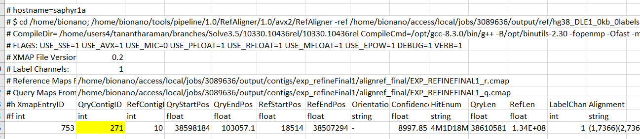
1 Xmap: All contigs aligned to reference
exp_refineFinal1_merged.xmap
REF Chromosome
Reference start/end
This tells you nick site by nick site whether it matched the reference M, had a deletion D, or has an insertion not on the reference I.
How do the nick sites match up
(reference, contig)
Contig/Molecule ID corresponds to qmap
These columns tell you the start and end of the query (which is the contig or molecule). The orientation tells you + if they match the reference and – if its reversed (end of query matches the start of ref then)

Slide 5
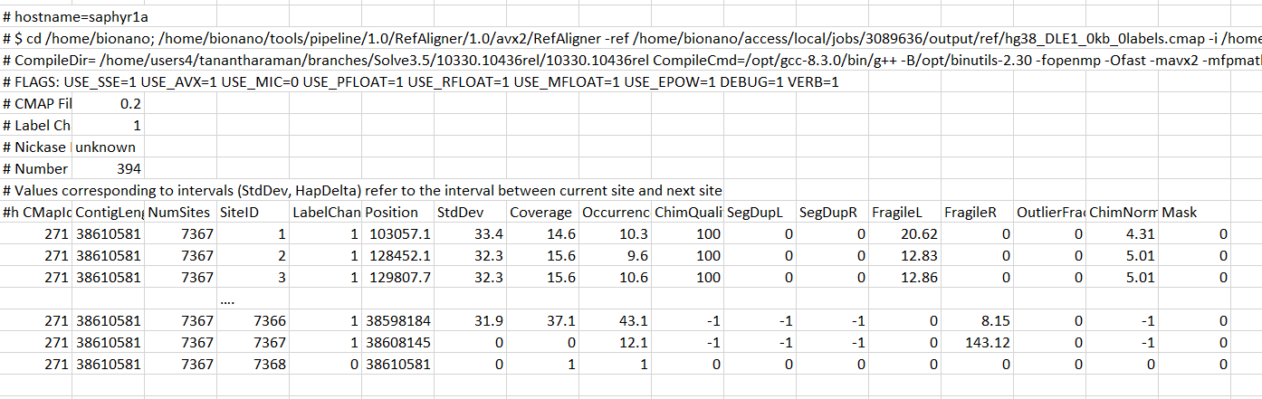
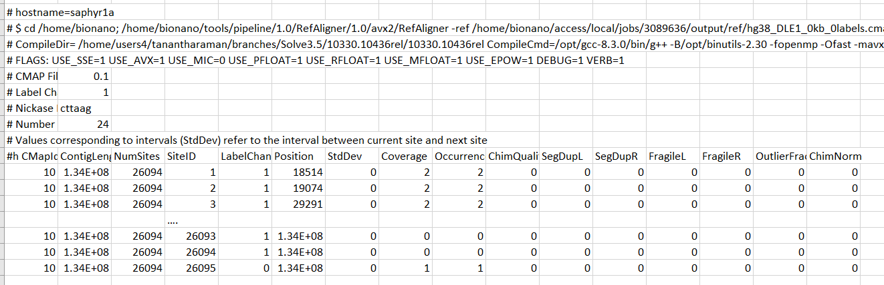
File types: Contig to Reference
q.cmap
exp_refineFinal1_merged _q.cmap
Contig Number
_q.maps correspond to the molecules or contigs, each molecule has several rows
ColA has the contig/molecule ID, the NumSites col C has the total number of rows that will correspond, the column over counts up to that number, col B has the length, the 6th column has the position of the nick sites
_r.maps have the reference information, and similar columns to the q maps
r.cmap
exp_refineFinal1_merged _r.cmap
Chr

Slide 6
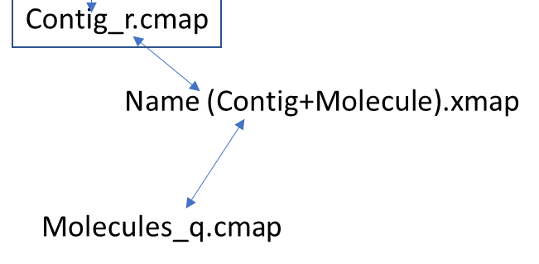
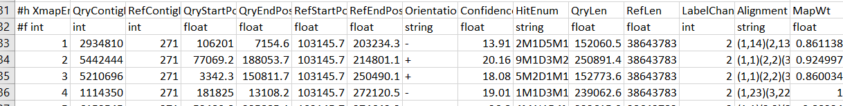
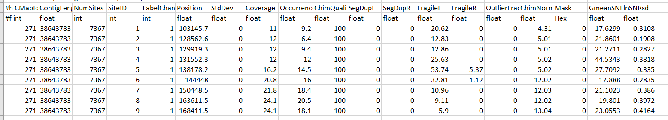
File Types: Molecules to Contig
.xmap
exp_refineFinal1_contig2671.xmap
Ref is now Contig
Molecule IDs
exp_refineFinal1_contig2671_q.cmap
q.cmap
r.cmap
exp_refineFinal1_contig2671_r.cmap
Contig Number

Slide 7
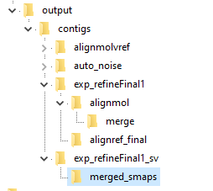
File Structure (de Novo assembly)
\output\contigs\exp_refineFinal1\alignref_final\EXP_REFINEFINAL1.xmap, EXP_REFINEFINAL1_q.cmap, EXP_REFINEFINAL1_r.cmap
Molecules aligned to contigs
exp_refineFinal1_contig2671.xmap
exp_refineFinal1_contig2671_q.cmap
exp_refineFinal1_contig2671_r.cmap
Contigs aligned to reference:
exp_refineFinal1_merged_q.cmap
exp_refineFinal1_merged_r.cmap
exp_refineFinal1_merged.xmap
Smaps (SVs)
Bash code example:
grep -v "#" EXP_REFINEFINAL1.xmap |awk '$2==272' > Contig272_xmapRow.txt

Slide 8
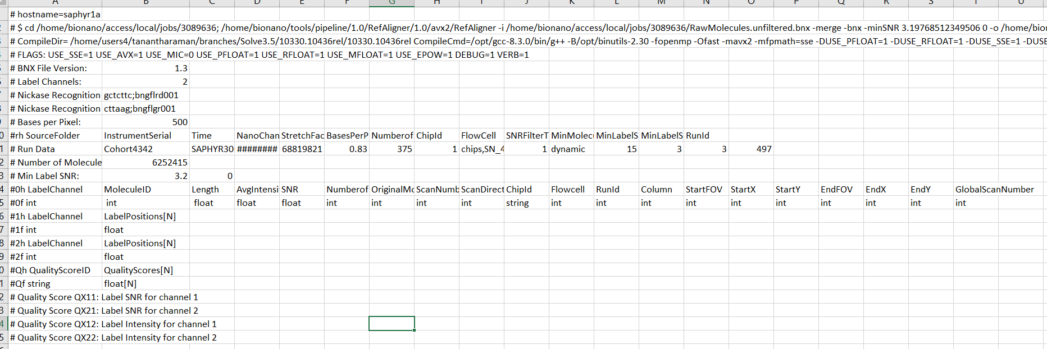
BNX 2 color file header
XXXX.bnx

Slide 9
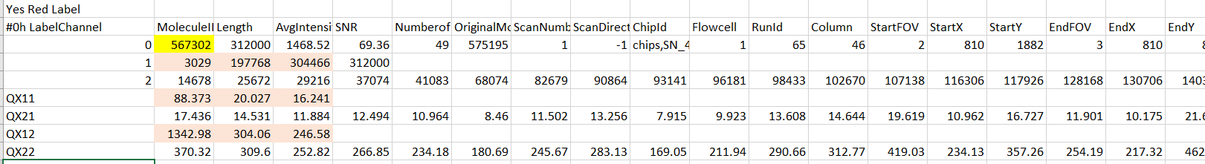
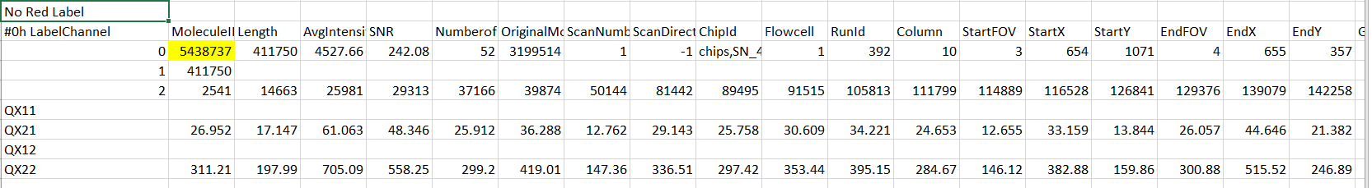
BNX 2 color labeling
Raw molecule information:
7 rows per molecule, width # columns is number of labels
label position
Red
Green
Xmap rows for these 2 molecules

Slide 10
BNX Molecule File – Green label only
#0h LabelChannel MoleculeID Length AvgIntensity SNR NumberofLables OriginalMoleculeId ScanNumber ScanDirection ChipId Flowcell RunId GlobalScanNumber
#1h LabelChannel LabelPositions[N]
# Quality Score QX11: Label SNR for channel 1
# Quality Score QX12: Label Intensity for channel 1
# Quality Score QX14: Stitch Locations for channel 1

